Slide 1
Glass Welding Through Non-Flat Surface
Neuralink, US 2023/0069855 A1, Published 3/9/2023
6/8/2024

Slide 2
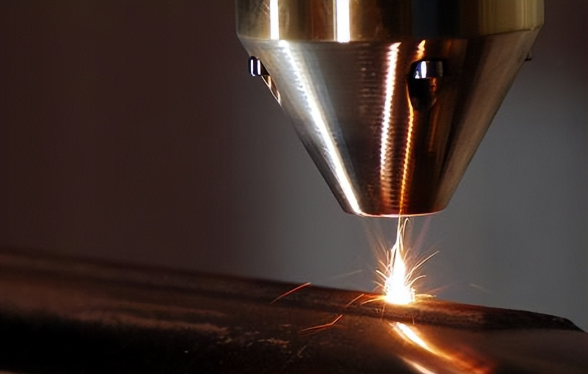
Background: Advantages & Drawbacks of Laser Welding
Laser welding advantages:
Greater precision compared to traditional welding techniques
Energy applied to narrower area by laser beam, less risk of heat distortion
Enables joining of dissimilar materials, allowing welding of complex joints with ease
Laser welding drawbacks:
Laser welding becomes difficult on curved surfaces (steeper curves --> greater distortion, differing angles of incidence in laser beam)
Edge-to-edge welding presents “clipping” issues – loss of energy as laser beam approaches edge (even worse for curved surfaces)
Superficial flaws (rough finishes/residuals) absorbs energy, rending welding ineffective
Biological implants – require hermetically sealed glass housing to prevent bio-reactivity and/or bodily fluids from corroding/degrading componentry inside housing

Slide 3
Outline
Goal: Describe method & system for laser beam welding an object with non-flat (e.g., curved) surfaces, with at least one transparent piece of the object
Purpose: Hermetically seal two pieces of hardware (with non-flat surfaces) to prevent corrosion of parts via laser beam welding
Embodiments:
Workpiece + Optical Guide (curved surface)
Workpiece + Optical Guide (varied surface)
1 Workpiece embodiment
Top + Bottom view of Optical Guide
Cross-section view of Workpiece with Curved Surface joined by Laser Welding, utilizing clear optical guide
Cross-section view of Workpiece Workpiece joined at an edge, utilizing an optical guide
Flowchart of Laser Welding through Curved Transparent material

Slide 4
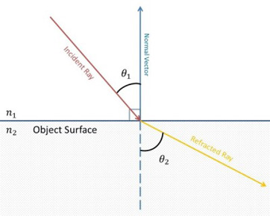
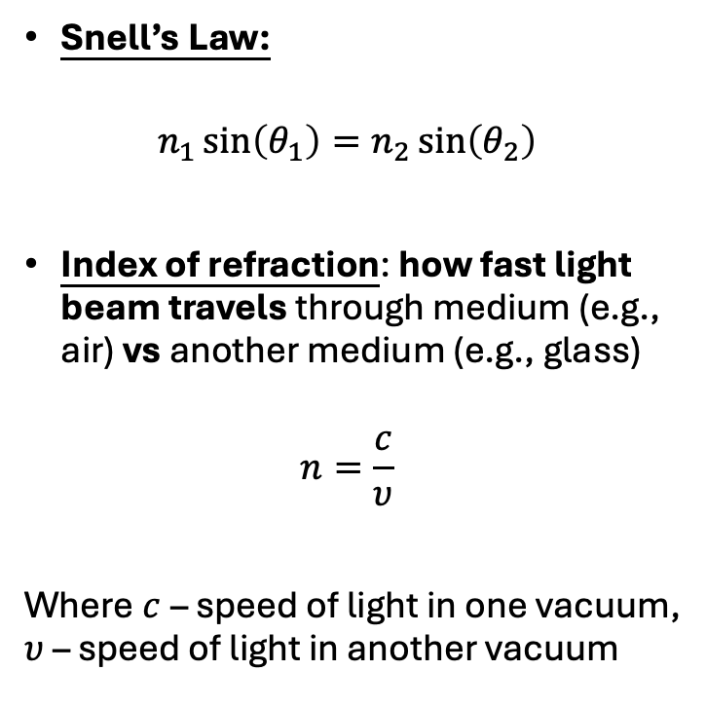
Basics: Refraction (Snell’s Law)
Snell’s Law:
$$n_{1}\sin\left(θ_{1}\right)=n_{2}\sin\left(θ_{2}\right)$$
Index of refraction: how fast light beam travels through medium (e.g., air) vs another medium (e.g., glass)
$$n=\frac{c}{υ}$$
Where $c$ – speed of light in one vacuum, $υ$ – speed of light in another vacuum

Slide 5
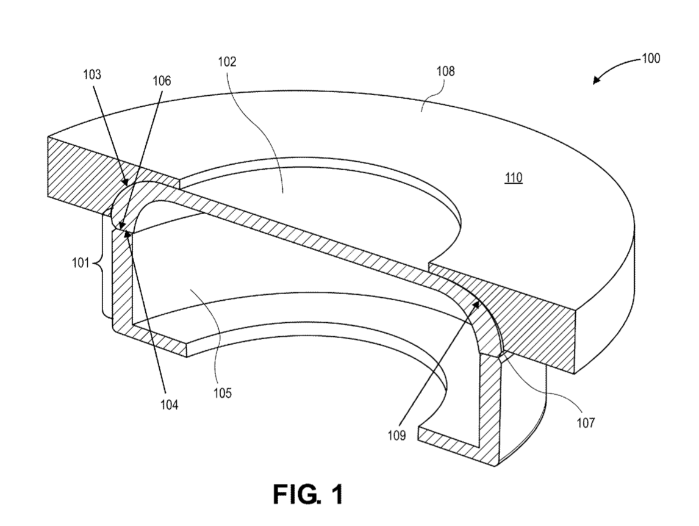

Workpiece + Optical Guide (curved surface)
Transparent First piece
index of refraction = 1.51
Borosilicate glass
Second target surface
Optical guide
Curved surface
Flat surface
Workpiece
Liquid optical medium
Assembly submerged in liquid optical medium
Thin layer to mitigate unwanted effects of rough finish
Fill gaps between different pieces
refractive index within 10% of index of refraction of transparent first piece
E.g., mineral oil (refractive index 1.47), lanolin, cedar wood oil, castor oil, glycerol, kerosene, etc.
Second piece
First target surface
* Can include ANY number of pieces
Interface surface

Slide 6
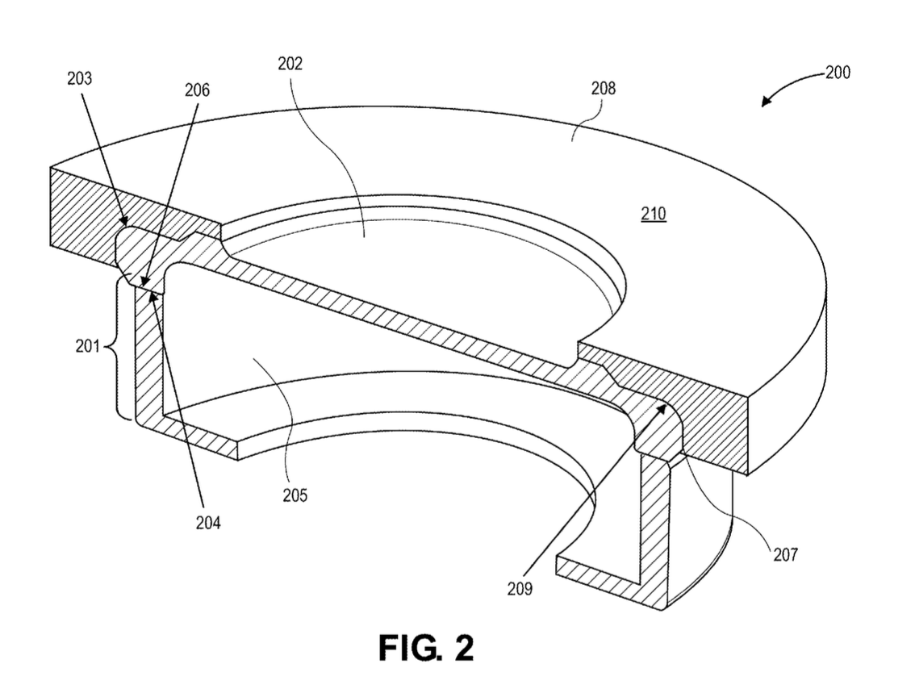
Workpiece + Optical Guide (varied surface)
Varied surface
Second target surface
Transparent First piece
Optical guide
Flat surface
Workpiece
First target surface
Second piece
* Can include ANY number of pieces
Liquid optical medium
Interface surface

Slide 7
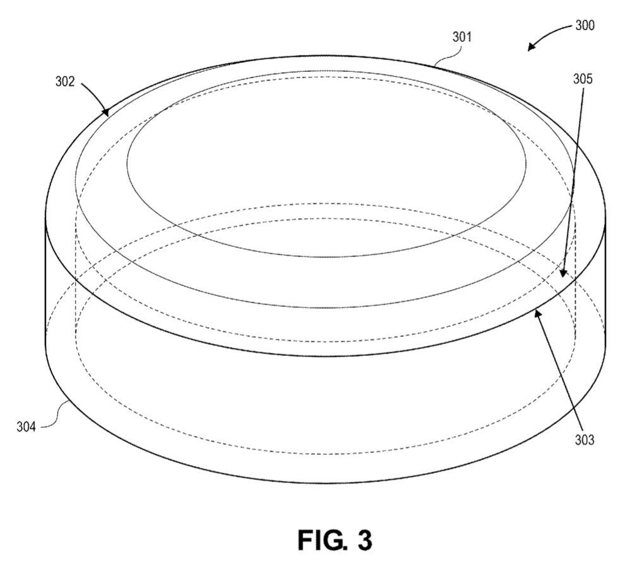
Workpiece
Workpiece:
Transparent first piece + second piece
Hermetically sealed (first & second target surfaces matched together)
May contain thin-film electrodes, system-on-a-chip packages, IC packages, etc.
May be a biological implant housing, optical device (with diffractive gratings, prisms, etc.), housing for MEMS devices, sensors, etc.
Transparent First piece
permits light propagation
glass, sapphire, etc.
Made from borosilicate glass, non-silicate glass, quartz, etc.
Curved surface
Formed by initial fabrication of transparent first piece (e.g., molding), or via grinding process – leaving rough surfaces
Rough surface – does not allow transmission of light (can be mitigated by liquid optical medium)
Second target surface
- similar to first target surface
Second piece - Same as first piece
- Can be made from same material as first piece, or metals (stainless steel, carbon steels, etc.)
First target surface
Width less than radius of first transparent piece and/or second piece – hollow space within workpiece

Slide 8
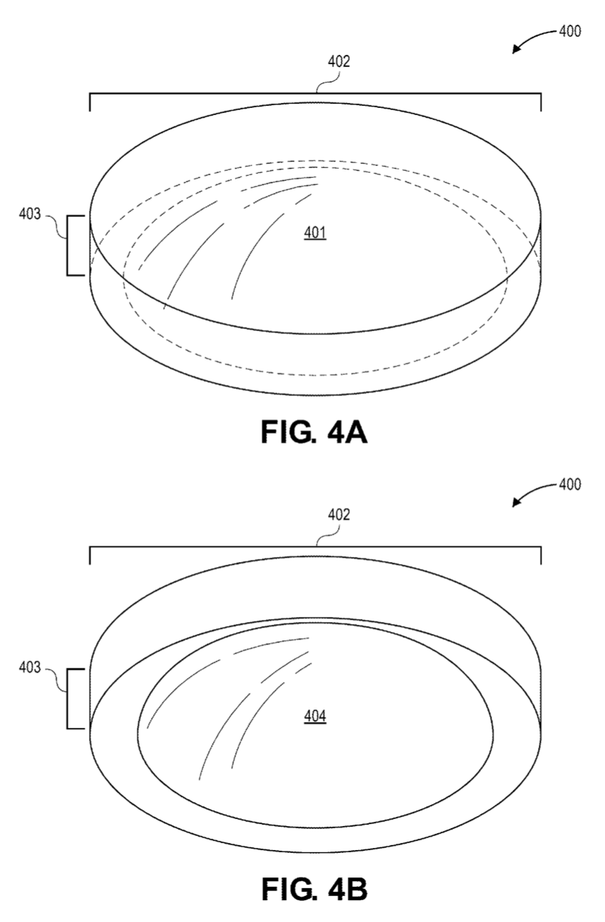
Top + Bottom view of Optical Guide
Optical guide
Facilitate formation of workpiece via laser welding
Made from sapphire, glass, or any transparent materia
Within 10% of index of refraction of workpiece
Width > workpiece width
(laser welding achieved regardless of workpiece width)
width
Depth
Optical guide extends beyond welding location (enable edge-to-edge welding)
depth
Flat surface
Interface surface
Concave
Form-fit curved surface
Can have ANY geometry
Top
Bottom

Slide 9
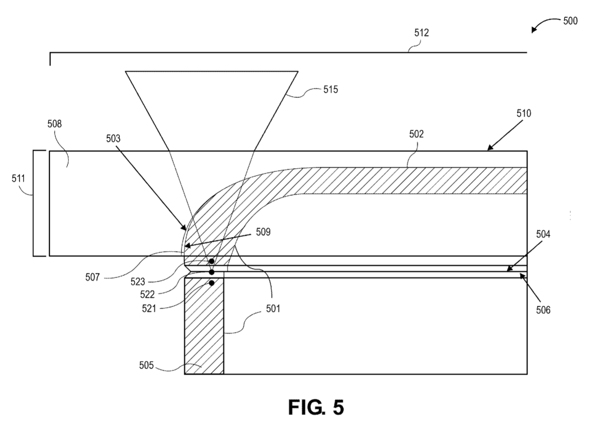


Cross-section view of Workpiece with Curved Surface joined by Laser Welding, utilizing a Clear Optical Guide
Identify first location on one piece
Identify second location on opposite piece
Define path between first and second location
Direct laser beam along path to create welds
Direct laser beam to another location to create welds
Repeat until curved workpiece is sealed (meeting / exceeding parameter)
width
Laser beam
glass
Optical guide
Curved surface
Laser beam
(pulse freq:
1-500 * 10^-15 s)
Transparent first piece
Flat surface
Depth
Liquid optical medium
Equal or within 20% of index of refraction of transparent first piece
Mineral oil
Fill gaps between interface & curved surface
refraction
Interface surface
First target surface
Second location
Welding location
First location
Curved workpiece
Second target surface
Normal welding conditions – depth of optical guide not as deep
Second piece

Slide 10
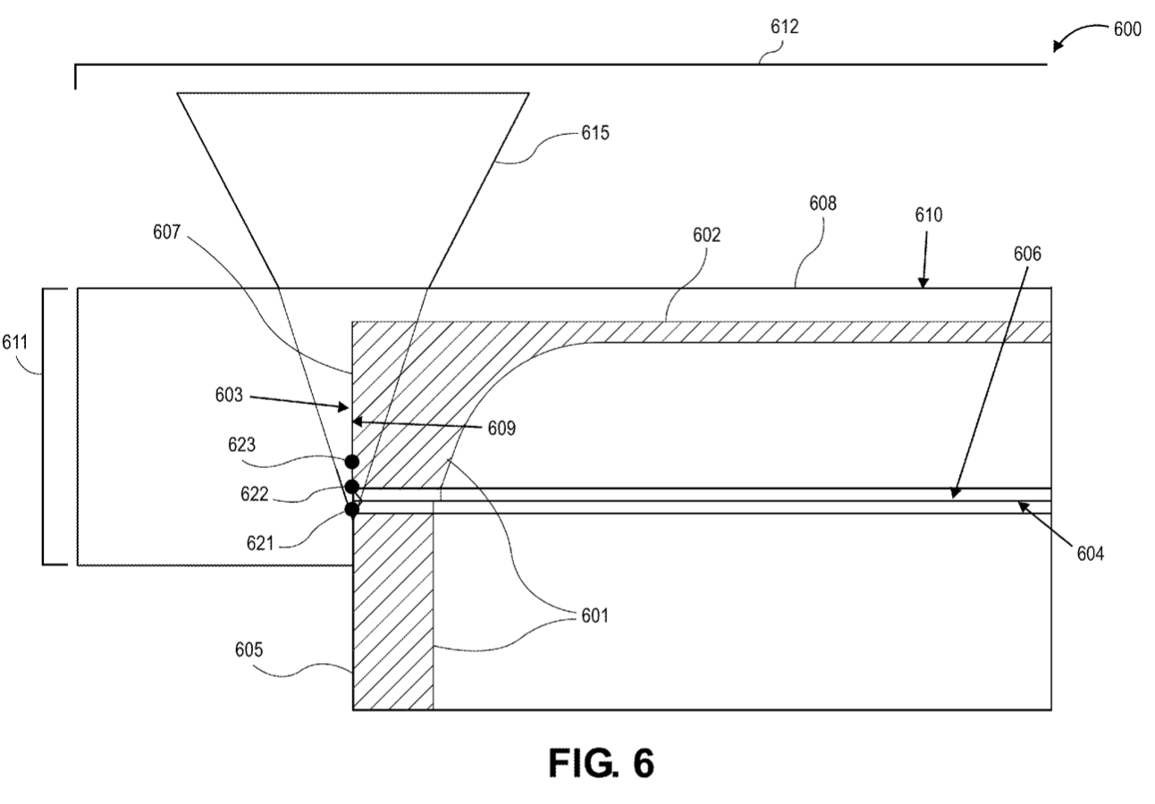
Cross-section view of Workpiece with Curved Surface joined at an edge, utilizing an Optical Guide
width
Optical guide
Flat surface
Laser beam
Transparent first piece
Liquid optical medium
Second target surface
Depth
Allows edge-to-edge welding:
Extend past first target surface + covering location to be welded + partially cover second target surface
Curved surface
Interface surface
Second location
Welding location
First target surface
First location
Edge-to-edge welding – much deeper depth of optical guide (covers first target surface + welding location + second location to weld)
Second piece
Curved workpiece

Slide 11
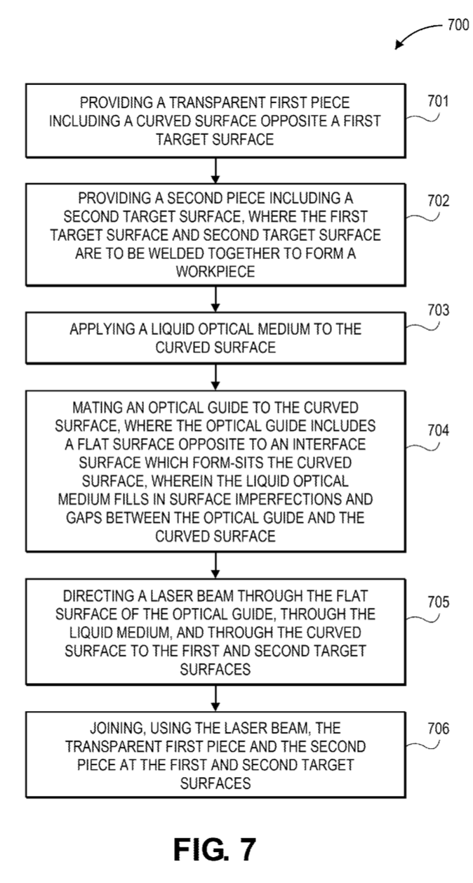
Flowchart of Laser Welding through Curved Transparent Material

Slide 12
Step 1:
Transparent first piece
Curved surface
First target surface

Slide 13
Step 2:
Transparent first piece
Workpiece
Curved surface
Second target surface
Second piece
First target surface

Slide 14

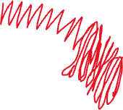





Step 3:
Curved surface
Liquid Optical Medium

Slide 15
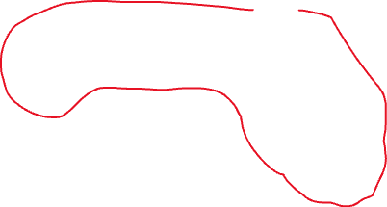
Step 4:
Optical guide
Liquid Optical Medium

Slide 16
Step 5:
Optical guide
Flat surface
Laser beam
Transparent first piece
Liquid optical medium
Second target surface
Curved surface
First target surface
Second piece

Slide 17
Step 6:
Laser beam
Transparent first piece
Second target surface
Interface surface
First target surface
Second piece

Slide 18
Additional Steps
Identify first location on one piece
Identify second location on opposite piece
Define path between first and second location
Direct laser beam along path to create welds
Direct laser beam to another location to create welds
Repeat until curved workpiece is sealed (meeting / exceeding parameter)
Optical guide
Flat surface
Laser beam
Transparent first piece
Liquid optical medium
Second target surface
Curved surface
Interface surface
Second location
Welding location
First location
First target surface
Second piece
Curved workpiece

